Slide 1
Introduction to Management and Organizations
Management
Stephen P. Robbins Mary Coulter
tenth edition
Chapter
1

Slide 2
Learning Outcomes
Follow this Learning Outline as you read and study this chapter.
1.1 Who Are Managers?
  Explain how managers differ from non-managerial employees.
  Describe how to classify managers in organizations.
1.2 What Is Management?
  • Define management.
  • Explain why efficiency and effectiveness are important to management.

Slide 3
Learning Outcomes
1.3 What Do Managers Do?
  Describe the four functions of management.
    Planning, Organizing, Leading, Controlling
  Explain Mintzberg’s managerial roles.
    Interpersonal(leader)
    Information role(spoke person)
    Decisional role(Disturbance Handler and Resource Allocator)
    Action(Thougthful thinking and practical role)
  Describe Katz’s three essential managerial skills and how the importance of these skills changes depending on managerial level.
    Technical Skills (job specific knowledge and technique) For First Line manager
    Human Skills (ability to work well with other people both individually and in a group) Middle manager
    Conceptual Skills (skills managers use to think and to conceptualize about abstract and complex situations) Top Manager
    Customer Dealing
    Innoviation
Discuss the changes that are impacting manager’s jobs.
    Welcome to the new world of managing!, In today’s world, managers are dealing with global economic and political uncertainties, changing workplaces, ethical issues, security threats, and changing technology. For example, Important Managerial SkillsWhen the company’s board of directors gave senior management complete freedom to ensure the company’s survival, they made a bold move.
  Explain why customer service and innovation are important to the manager’s job.
    Managers are recognizing that delivering consistent high-quality customer service is essential for survival and success in today’s competitive environment and that employees are an important part of that equation.
    Managers are recognizing that delivering consistent high-quality customer service is essential for survival and success in today’s competitive environment and that em- ployees are an important part of that equation.

Slide 4
Learning Outcomes
1.4 What Is An Organization?
Explain the characteristics of an organization.
  Describe how today’s organizations are structured.
1.5 Why Study Management?
  Discuss why it’s important to understand management.
  Explain the universality of management concept.
  Describe the rewards and challenges of being a manager.
    Ans: It’s important to study management for three reasons: (1) the universality of management, which refers to the fact that managers are needed in all types and sizes of organizations, at all organizational levels and work areas, and in all global locations; (2) the reality of work—that is, you will either manage or be managed; and (3) the awareness of the signif- icant rewards (such as, creating work environments to help people work to the best of their ability; supporting and encouraging others; helping others find meaning and fulfill- ment in work; etc.) and challenges (such as, it’s hard work; may have more clerical than managerial duties; have to deal with a variety of personalities; etc.) in being a manager

Slide 5

Who Are Managers?
Manager
  Someone who coordinates and oversees the work of other people so that organizational goals can be accomplished.

Slide 6
Classifying Managers
First-line Managers
  Individuals who manage the work of non-managerial employees.
Middle Managers
  Individuals who manage the work of first-line managers.
Top Managers
  Individuals who are responsible for making organization-wide decisions and establishing plans and goals that affect the entire organization.

Slide 7
Exhibit 1–1 Women in Managerial Positions Around the World
Women in
Management
Australia 41.9 percent
Canada 36.3 percent
Germany 35.6 percent
Japan 10.1 percent
Philippines 57.8 percent
United States 50.6 percent
Women in Top
Manager’s Job
3.0 percent
4.2 percent
N/A
N/A
N/A
2.6 percent

Slide 8
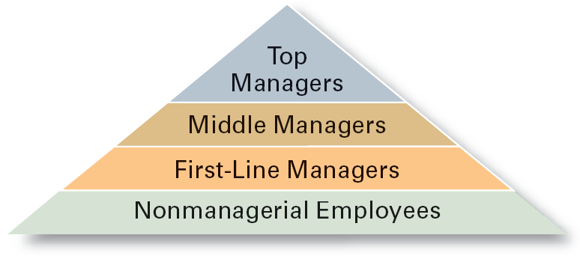
Exhibit 1–2 Managerial Levels

Slide 9
What Is Management?
Management involves coordinating and overseeing the work activities of others so that their activities are completed efficiently and effectively.

Slide 10

What Is Management?
Managerial Concerns
  Efficiency
    “Doing things right”
      Getting the most output for the least inputs
  Effectiveness
    “Doing the right things”
      Attaining organizational goals

Slide 11
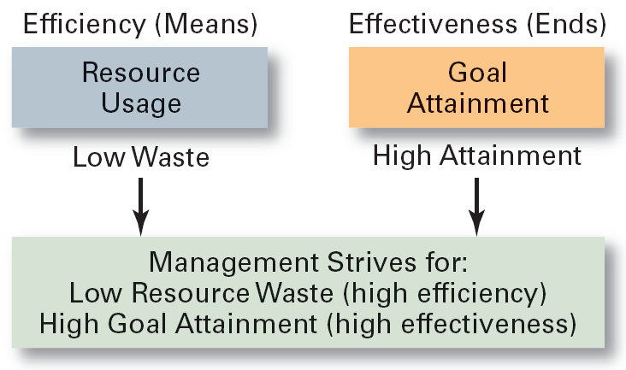
Exhibit 1–3 Effectiveness and Efficiency in
Management

Slide 12
What Managers Do?
Three Approaches to Defining What Managers Do.
  Functions they perform.
  Roles they play.
  Skills they need.

Slide 13
What Managers Do?
Functions Manager’s Perform
  Planning
    Defining goals, establishing strategies to achieve goals, developing plans to integrate and coordinate activities.
  Organizing
    Arranging and structuring work to accomplish organizational goals.
  Leading
    Working with and through people to accomplish goals.
  Controlling
    Monitoring, comparing, and correcting work.

Slide 14
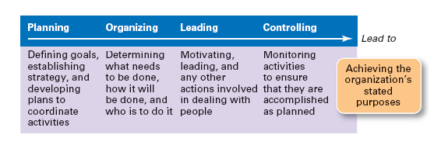
Exhibit 1–4 Management Functions

Slide 15
What Managers Do?
Roles Manager’s Play
  Roles are specific actions or behaviors expected of a manager.
  Mintzberg identified 10 roles grouped around interpersonal relationships, the transfer of information, and decision making.

Slide 16

What Managers Do?
Management Roles (Mintzberg)
  Interpersonal roles
    Figurehead, leader, liaison
  Informational roles
    Monitor, disseminator, spokesperson
  Decisional roles
    Entrepreneur, disturbance handler, resource allocator, negotiator

Slide 17
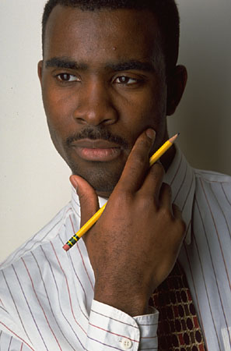
What Managers Do (Mintzberg)
Actions
  thoughtful thinking
  practical doing

Slide 18
Exhibit 1.5 Mintzberg’s Managerial Roles
Interpersonal Roles
  • Figurehead
  • Leader
  • Liaison
Informational Roles
  • Monitor
  • Disseminator
  • Spokesperson
Decisional Roles
  • Entrepreneur
  • Disturbance handler
  • Resource allocator
  • Negotiator
Adapted from Mintzberg, Henry,
The Nature of Managerial Work,
1st Edition, © 1980, pp. 93–94..

Slide 19
What Managers Do?
Skills Managers Need
  Technical skills
    Knowledge and proficiency in a specific field
  Human skills
    The ability to work well with other people
  Conceptual skills
    The ability to think and conceptualize about abstract and complex situations concerning the organization

Slide 20
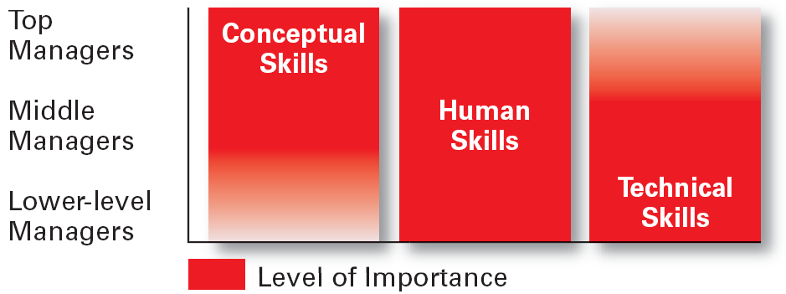
Exhibit 1–6 Skills Needed at Different
Management Levels

Slide 21
How The Manager’s Job Is Changing
The Increasing Importance of Customers
  Customers: the reason that organizations exist
    Managing customer relationships is the responsibility of all managers and employees.
    Consistent high quality customer service is essential for survival.
Innovation
  Doing things differently, exploring new territory, and taking risks
    Managers should encourage employees to be aware of and act on opportunities for innovation.

Slide 22
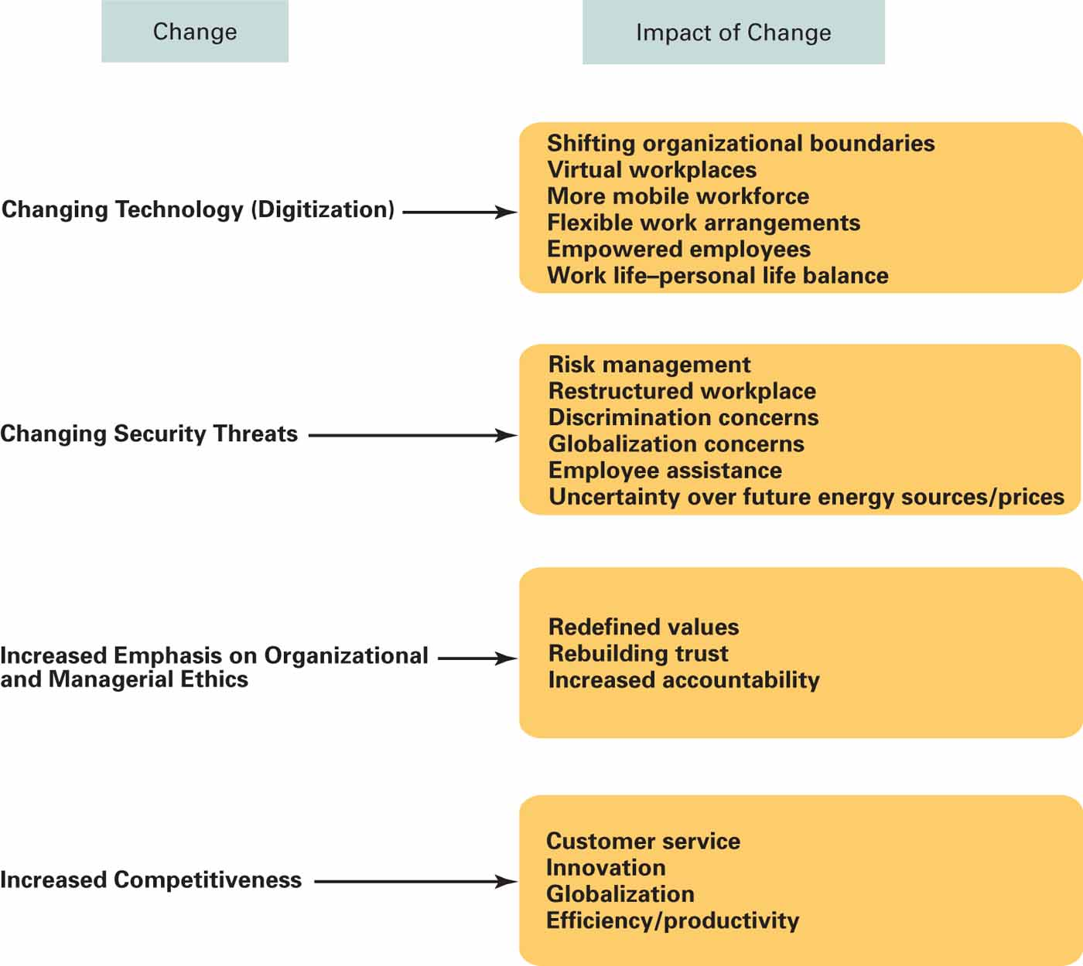
Exhibit 1–8
Changes Affecting a Manager’s Job

Slide 23
What Is An Organization?
An Organization Defined
  A deliberate arrangement of people to accomplish some specific purpose (that individuals independently could not accomplish alone).
Common Characteristics of Organizations
  Have a distinct purpose (goal)
  Composed of people
  Have a deliberate structure

Slide 24
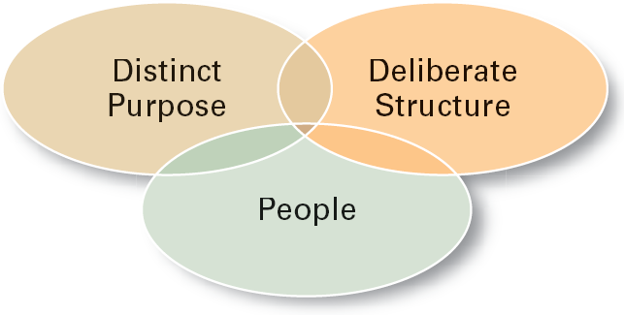
Exhibit 1–9 Characteristics of Organizations

Slide 25
Why Study Management?
The Value of Studying Management
  The universality of management
    Good management is needed in all organizations.
  The reality of work
    Employees either manage or are managed.
  Rewards and challenges of being a manager
    Management offers challenging, exciting and creative opportunities for meaningful and fulfilling work.
    Successful managers receive significant monetary rewards for their efforts.

Slide 26
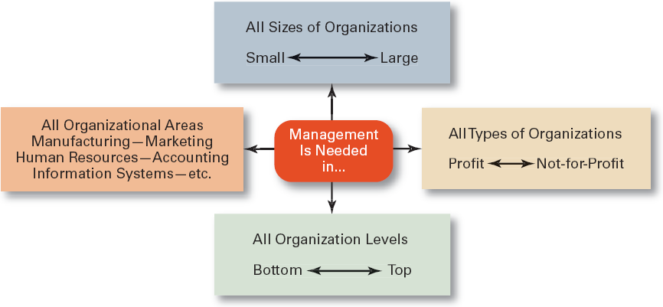
Exhibit 1–10 Universal Need for Management

Slide 27
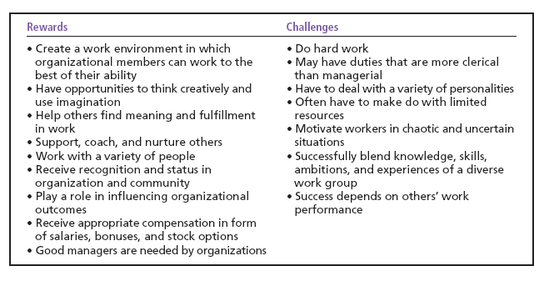
Exhibit 1–11 Rewards and Challenges of
Being A Manager

Slide 28
Terms to Know
manager
first-line managers
middle managers
top managers
management
efficiency
effectiveness
planning
organizing
leading
controlling
management roles
interpersonal roles
informational roles
decisional roles
technical skills
human skills
conceptual skills
organization
universality of management

Slide 29

All rights reserved. No part of this publication may be reproduced, stored in a retrieval system, or transmitted, in any form or by any means, electronic, mechanical, photocopying, recording, or otherwise, without the prior written permission of the publisher. Printed in the United States of America.

